Slide 1

West Villages Improvement District
Presentation on Irrigation Program to
Gran Paradiso HOA
July 13, 2022

Slide 2
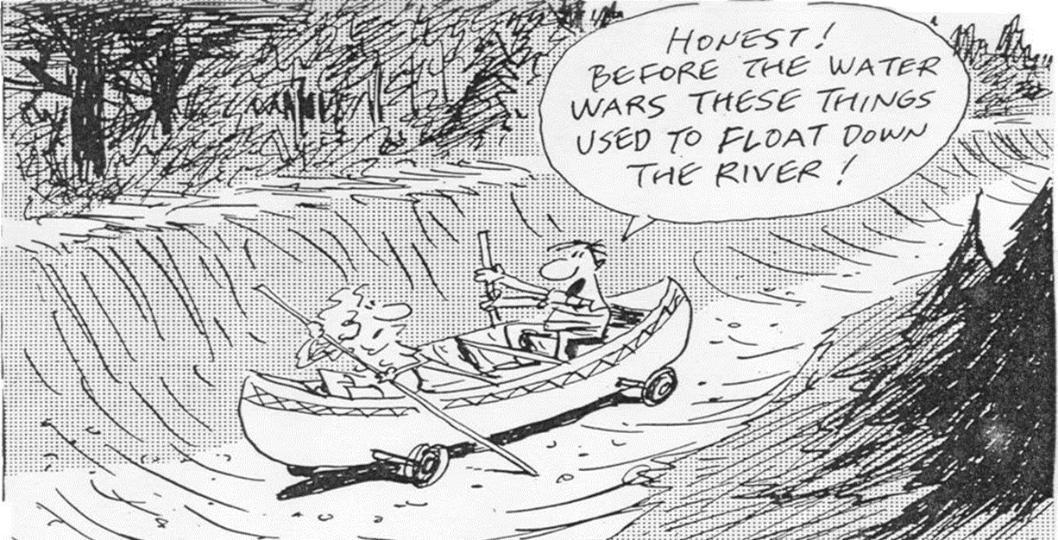

Slide 3
Who Owns the Water in Florida?

Slide 4
The Florida Department of Environmental Protection (“DEP”)
Responsible for the administration of the water resources at the state level
Exercises general supervisory authority over the state’s five water management districts (“WMD’s”)
Issues guidance memorandums to the WMD’s
Authorized to issue water use permits
Authorized to adopt minimum flows and levels, if requested by WMD’s
Water Resource Implementation Rule set forth in Chapter 62-40, Florida Administrative Code

Slide 5
Water Management Districts
Five independent special districts with ad valorem taxation powers
Boundaries
Responsible for managing and protecting water resources
  Water Supply
  Flood Protection
  Water Quality
  Natural Systems
Appointed Governing Boards
Wellen Park is located within the jurisdiction of the Southwest Florida Water Management District (“SWFWMD”)

Slide 6
Consumptive Use of Water
Exclusive jurisdiction of DEP and WMDs
A water use permit is permission to use the ground or surface water natural resources
  Allows withdrawal, use or diversion of a specified amount of water from the ground or surface water
Not permanent – specified duration
The proposed use:
  1. is a reasonable-beneficial use;
  2. will not interfere with any presently existing legal use of water; and
  3. is consistent with the public interest
The use or diversion of water is a consumptive use
The WMD may require permits and impose reasonable conditions

Slide 7
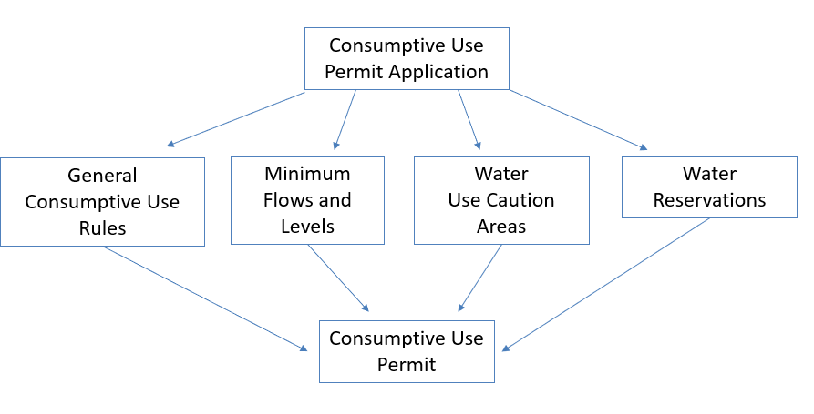
Factors Considered in Water Use Permit Issuance

Slide 8
Ownership/Control of the Lands Subject to the Water Use Permit
Rule 40D-1.6105, Florida Administrative Code (Limiting Conditions)
  “All permits issued pursuant to these rules are contingent upon the continued ownership, lease, or other legal control of property rights in underlying, overlying, or adjacent lands, or the power to acquire such property rights through eminent domain.”
SWFWMD Water Use Permit Applicant’s Handbook, Part B (1.4.13 Control of Property and Activities)
  Water use permit applicants must demonstrate ownership or legal control of all property on which pumps, wells, diversions or other permitted facilities are or will be located
Easements meets the requirements of these rules

Slide 9
History of the Wellen Park Water Use Permit
1991
Permit # 20-00387.003 (now 20-00387.020) (the “WUP”) was originally issued in 1991 to the original developer- Taylor Ranch, Inc.
2003
Fourth Quarter Properties XXII LLC (“Fourth Quarter”) acquired the project and was updated as the permittee in 2003
Note: The wells within Gran Paradiso were added to the scope of the permit in 2013
early 2014
The Master Developer acquired the West Villages/Wellen Park project in early 2014
June 2014
Rights to the WUP, including the rights to the wells and the water generated therefrom, were assigned to the Master Developer in June 2014
2018
WVID was added as a co-permittee on the WUP in 2018
2018
Current AGMOD allocations for the entire Wellen Park project were incorporated into the WUP in 2018

Slide 10
Basics of
WUP 20-00387.020
Permittee: WVID and the Master Developer
The permittee holds the sole and exclusive right to the following within Wellen Park:
  1. Surface water (i.e. irrigation lakes)
  2.Reclaimed water (i.e. supplied by the City of North Port, Sarasota County, and/or Englewood Water District)
  3. Groundwater (i.e. wells)
Expires: August 24, 2068
Use: Landscape/Recreation and Agricultural

Slide 11
WUP 20-00387.020 Wellen Park Irrigation Allocations
The WUP dictates the amount of irrigation water available to the Wellen Park development, as well as to the individual communities within Wellen Park
Permitted quantities are based on SWFWMD’s irrigation allocation calculation program (AGMOD)
  The AGMOD calculation is based on the amount of irrigable acres located within a specific project boundary, as well as property use type, irrigation type, and soil type
  Capacity of the wells, volume of irrigation storage lakes, etc. are not relevant
The AGMOD allocation for Wellen Park per the WUP is:
  Annual Average: 2,489,800 gpd
  Peak Month: 6,735,900 gpd

Slide 12
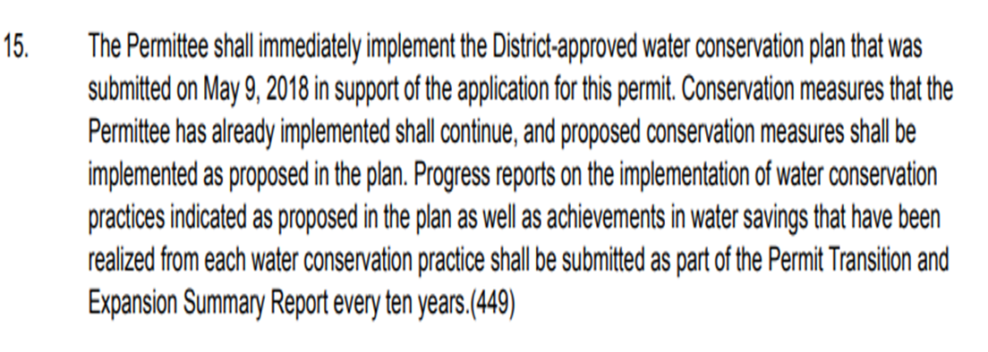
WUP 20-00387.020 - Conservation Conditions
WVID and the Master Developer are required to implement the SWFWMD-approved May 2018 Water Conservation Plan
  i.e. violation of the conservation plan is a violation of the WUP
In relevant part, the Water Conservation Plan, has the following requirements:
  1. WVID/Master Developer are to supply irrigation water to the customer (i.e. the community HOAs) based on SWFWMD’s AGMOD irrigation allocation program
  2. Customers (i.e. the community HOAs) must create and implement their own water conservation plan
  3. WVID/Master Developer must ensure the customers’ (i.e. the community HOA’s) compliance with the AGMOD allocations

Slide 13
WUP
20-00387.020 Conservation Conditions
1. Supply of water based on AGMOD
  “The WVID will supply water to meet the customers demand based on [SWFWMD’S] AGMOD irrigation allocation program”
2. Customers must create and implement a water conservation plan
  “Prior to any customer receiving irrigation water from WVID, the customer must apply a water conservation plan that at a minimum addresses the following practices outlines below.”

Slide 14
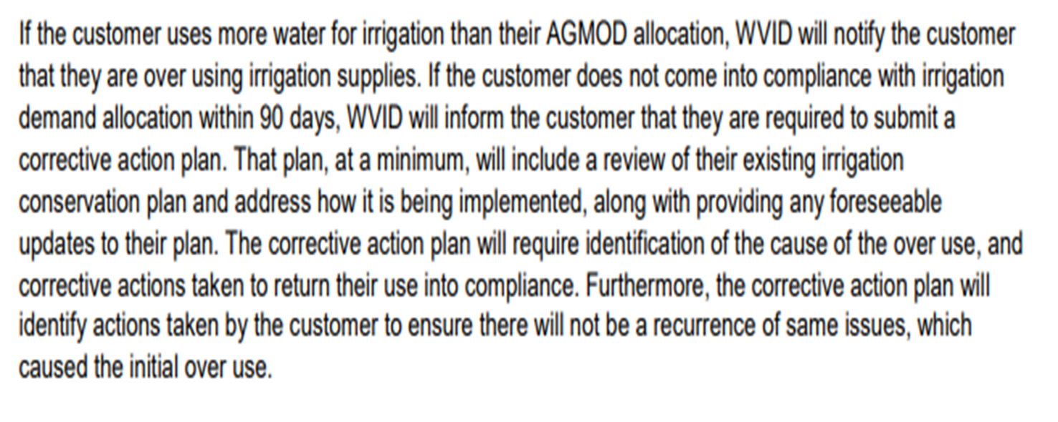
WUP
20-00387.020 Conservation Conditions
3. Customer compliance with AGMOD allocations

Slide 15
WVID Unit of Development No. 6
Unit of Development No. 6 (“Unit No. 6”) was established in August 2018 for the purposes of facilitating WVID’s operation of its irrigation utility and implementation of the terms of the WUP
  Note: the Unit No. 6 boundary is planned to be amended at the July WVID meeting of its Board of Supervisors (the “Board”) to include additional lands within the unit that were recently added to the WVID boundary
The boundary includes all lands within the Wellen Park development, except Islandwalk which is separately permitted
  In addition to the WUP, the obligation for properties within Wellen Park to utilize the WVID irrigation program and pay the associated irrigation rates emanates from several sources:
    1. Restrictive Covenants
    2.WVID/Master Developer Water Supply Agreement
    3. WVID’s Enabling Legislation
    4. WVID/HOA Irrigation Agreements

Slide 16
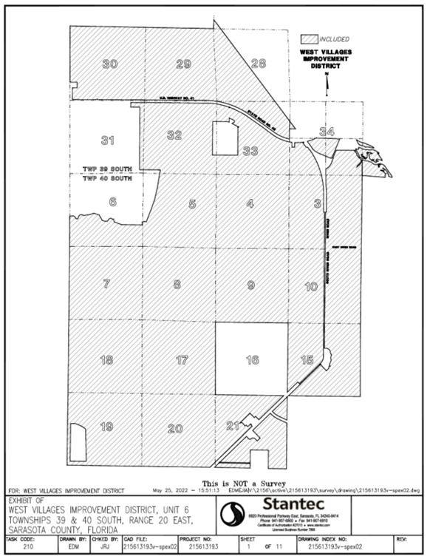
Map of WVID Unit of Development No. 6

Slide 17
A Systems Approach to Irrigation
Both the WUP and WVID’s implementation of the WUP via Unit No. 6 are predicated on the fact that the irrigation program utilizes a “systems approach”
  i.e. the irrigation infrastructure within Unit No. 6 generally serves the entirety of the lands within Unit No. 6 instead of just the development in which they are physically located
Thus, wells and infrastructure outside of a community can provide irrigation water to such community and conversely the wells and other infrastructure located within a community can be utilized to provide irrigation water to other properties outside the community
Example: water generated from Gran Paradiso wells has to be mixed with water from an irrigation lake located outside of Gran Paradiso in order to reduce the salinity to a point where the irrigation water is useable

Slide 18
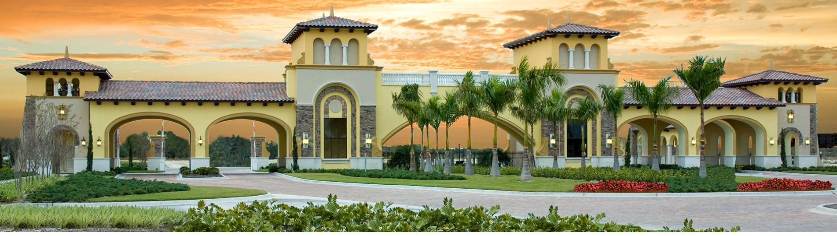
Gran Paradiso

Slide 19
Obligation for Gran Paradiso to Utilize the WVID Irrigation Program
In addition to the WUP, the obligation for Gran Paradiso residents to utilize the WVID irrigation program and pay the associated irrigation rates emanates from several sources:
  1. Gran Paradiso Restrictive Covenants
  2. WVID/ Master Developer Water Supply Agreement
  3. WVID’s Enabling Legislation
  4. WVID/GPHOA Irrigation Agreement

Slide 20
1. Gran Paradiso Restrictive Covenants
Amended and Restated Declaration of Covenants and Restrictions for Gran Paradiso
  This restrictive covenant over the lands in Gran Paradiso provides for a mandatory irrigation system
    Sections 5.12 (and 13.5)-“Each Owner shall be required to connect the water lines on its lot to the lines of the utility provider(s) providing service to Gran Paradiso.”
      Note: WVID is the only source of irrigation water to the lands within Wellen Park pursuant, to the WUP
  The restrictive covenant also discloses the existence of WVID and its authority to levy and collect assessments, rates, fees and charges to provide and operate infrastructure

Slide 21
2.WVID/ Master Developer Water Supply Agreement
Entered into November 2018
Governs all of the lands within Unit No. 6
Establishes a well availability fee to be charged to WVID
Establishes the manner of/time for payment for such fees to the Master Developer

Slide 22
3. WVID Enabling Legislation
Section (3)(2)(q) of WVID’s enabling legislation authorizes the district to “prescribe, fix, establish, and collect rates, fees and other charges after a public hearing”
WVID procured an independent rate study from Stantec Inc., which was reviewed and approved by the Board of Supervisors (the “Board”) in 2018
The rate study established 3 different types of rates (the “Irrigation Rates”):
  1. Operating/usage rate- i.e. how much water is utilized by a community
  2. Capital repair/replacement rate- i.e. the cost to repair infrastructure that was originally funded by the community developers and/or WVID
  3. Well availability fee- i.e. the rate charged by the Master Developer for WVID to utilize the water drawn from its wells for the purpose of irrigating the lands within Unit No. 6
WVID, after notice and advertised public hearings, has adopted two resolutions establishing irrigation rates:
  Resolution 2018-18 in September 2018 - approved initial rates based on rate study; approved rate study
  Resolution 2021-15 on September 2021- approved increased Tier 2 rates

Slide 23
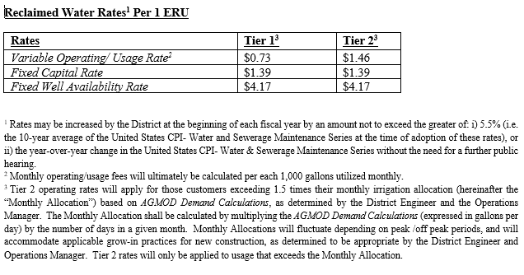
Current WVID Irrigation Water Rates

Slide 24
4. WVID/ GPHOA Irrigation Agreement
The most recent version was entered into December 2020
Establishes the Gran Paradiso Property Owners’ Association, Inc. (the “GPHOA”) obligation to remit payment for the Irrigation Rates charged by WVID
Recognizes that the GPHOA will pay the Irrigates Rates then in effect at a given time, as the rates may fluctuate over time as determined by WVID
Acknowledges WVID’s authority to set rates, fees, and charges
Provides for a termination right only for:
  1. Breach of the agreement
  2. Termination of the WVID/Master Developer Water Supply Agreement; or
  3. If the provision of the irrigation water in the amounts addressed pursuant to the agreement is prohibited by operation of any statute or law or governmental permit, rule or order
Note: if the WVID/GPHOA Irrigation Agreement is terminated, then Gran Paradiso will have no access to irrigation water for the lands within the community

Slide 25
Gran Paradiso AGMOD Irrigation Allocations
The current AGMOD allocation for Gran Paradiso, per the WUP, is 558,700 gpd
  This allocation was determined in 2018, and is based on an estimated 277.3 acres of irrigation lawn and landscape area at project build-out
Note, however:
  The AGMOD allocation included in the WVID/GPHOA Irrigation Agreement is 593,200 gpd
  After receiving several inquiries in 2022 from GPHOA Board of Directors’ member John Meisel relative to the veracity of the calculation of the Gran Paradiso AGMOD allocation, WVID’s irrigation consultant confirmed that WVID inadvertently additionally included the AGMOD allocation for lands outside of Gran Paradiso in Gran Paradiso AGMOD allocation referenced in the WVID/GPHOA Irrigation Agreement
    i.e. the AGMOD allocation referenced in the WVID/GPHOA Irrigation Agreement is higher than what is permissible to be provided to Gran Paradiso pursuant to the WUP

Slide 26
Gran Paradiso AGMOD Irrigation Allocations (2)
Further, recall that AGMOD allocations for Gran Paradiso included in the WUP were determined based on estimated irrigable acres in 2018, when development of the community was not yet complete
  Lennar Homes, LLC (“Lennar”) has subsequently completed development of the Gran Paradiso community
In addition to reviewing the current WUP AGMOD allocations for Gran Paradiso which were determined to be over-stated in the WVID/GPHOA Irrigation Agreement, Mr. Meisel’s inquiries also spurred WVID’s irrigation consultant to request an updated development plan for the community from Lennar, to determine:
  1) total irrigable acres of common area and
  2) a final residential lot count
The current (and final) development plan for Gran Paradiso includes 271.6 acres of irrigation lawn and landscape area for the community
This total irrigable acreage yields a final AGMOD allocation for Gran Paradiso of 547,200 gpd
As a result, the Master Developer and WVID will notify SWFWMD of the revised final Gran Paradiso allocation in its next upcoming annual report, and will reduce the irrigation allocations to Gran Paradiso accordingly

Slide 27
Gran Paradiso AGMOD Irrigation Allocations (3)
  Otherwise- if WVID did not reduce the irrigation allocation to Gran Paradiso- WVID and the Master Developer would violate the Water Conservation Plan, which is a condition of the WUP
    i.e. by over-allocating irrigation water to Gran Paradiso, WVID is in violation of a governmental permit
    Note: this allows for the WVID/GPHOA Irrigation Agreement to be terminated, which would result in the Gran Paradiso community having no access to irrigation water for the lands within the community
  Rather than terminate the WVID/GPHOA Irrigation Agreement, WVID prefers to simply amend the agreement to update the community’s final AGMOD allocation
  WVID will soon be in contact with Gran Paradiso legal counsel to coordinate review and execution of the amendment to the WVID/GPHOA Irrigation Agreement to effectuate this change
  Note: If no amendment is executed, WVID will soon be forced to terminate the WVID/GPHOA Irrigation Agreement, leaving residents of Gran Paradiso with no source of irrigation water indefinitely

Slide 28
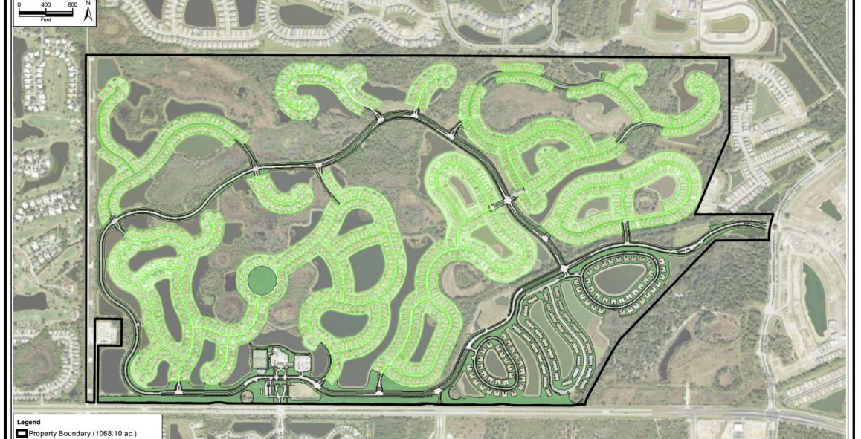

Slide 29
Right to Utilize the Gran Paradiso Wells
There are 6 permitted irrigation wells within the Gran Paradiso boundary, with 2 physically operational
The wells can provide water both within and outside of Gran Paradiso, as previously discussed
There have been several questions from the GPHOA regarding ownership of the wells
Keep in mind that there are two components of ownership:
  1. Real Property
    i.e. land
  2. Well improvements and water rights
    i.e. the right to draw groundwater from the physical improvement- the wells

Slide 30
1. Real Property
Conveyed to Lennar in 2013, and then to the GPHOA in 2020
Currently owned by the GPHOA
However, the Master Developer and WVID hold a perpetual easement over the real property upon which the wells are located
  This easement provides sufficient evidence of “control” for the purposes of WVID and the Master Developer obtaining the WUP
    i.e. fee simple ownership of the well real property is not required to own the rights to the wells

Slide 31
1. Real Property
(Well Easement)
Easement Agreement (Regarding Wells)
  Entered into February 2016 by Lennar (as the then-current owner of the real property) and the Master Developer
  Recorded in the public records and runs with the land
    i.e. it is binding on successor owners of the real property upon which the wells are located, including the GPHOA
Section 2- provides that the GPHOA acknowledges that the Grantee owns the rights to the wells
Section 3- provides that the Grantee has the right to access the real property upon which the wells are located for the purposes of “installation, maintenance, repair, and use of the [w]ells…for withdrawals”
Section 5- provides that the GPHOA acknowledges that the wells may supply groundwater for the Grantee’s use within WVID, including within Gran Paradiso, and that the Grantee may charge competitive rates for their provision of irrigation water to the GPHOA

Slide 32
2. Well Improvements & Water Rights
In June 2014, Fourth Quarter conveyed all right, title and interest in the WUP to the Master Developer
  The named permittees of the WUP = ownership of the rights to the wells
  Thus, the well improvements and water rights are currently owned by the Master Developer (and now WVID as a co-permittee)
    Thus, only the Master Developer and WVID can draw water from or otherwise utilize the wells
Pursuant to the Declaration of Covenants, Restrictions and Easements:
  1) no future wells can be dug, constructed or tolerated within Gran Paradiso without the Master Developer’s consent
  2) the conveyance of a lot to a homeowner does not include the right to develop or utilize the ground or surface water resources within such lot
Pursuant to the Amended and Restated Declaration of Covenants and Restrictions for Gran Paradiso:
  No property owner may install or operate a private well for any reason

Slide 33
The Master Developer and District Own the Right to Utilize the Gran Paradiso Wells
As a result, while the real property underlying the Gran Paradiso wells is owned by the GPHOA, the Master Developer and/or WVID own the rights to the well improvements and the accompanying water rights
Thus, the Master Developer and WVID are the only entities permitted to utilize the Gran Paradiso wells and the irrigation water drawn therefrom
  Any persons or entities attempting to tamper with or otherwise operate the wells are trespassing and will be prosecuted to the fullest extent of the law.

Slide 34
Questions?

