Slide 1

West Villages Improvement District
Irrigation Rate Study

Slide 2
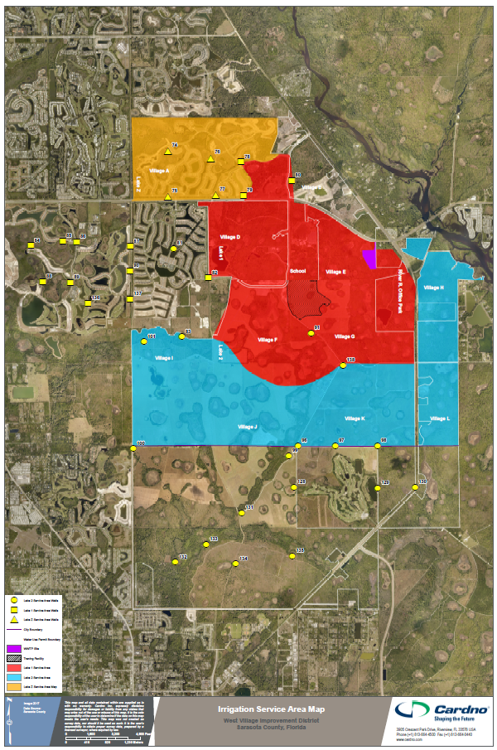
Background of Study
Purpose: Expansion of non-potable irrigation water demands within WVID’s service area is projected as development occurs
Key Objective: Develop an equitable non-potable water irrigation rate structure and rates to recover the projected operating and capital replacement costs for WVID to provide this service
Basis of Study?: Unit 6 excluding Sarasota County properties
Village B Included
Excludes Island Walk

Slide 3
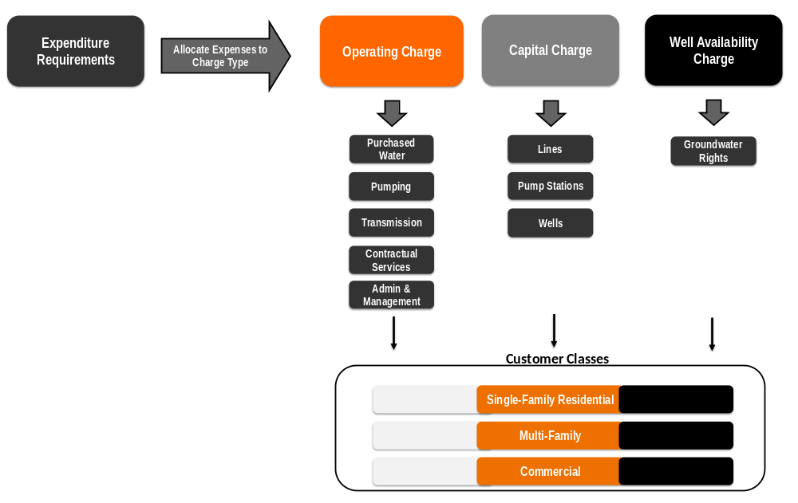
Irrigation Rate Study Framework

Slide 4

Key Assumptions
Rates based upon Unit 6 at build-out:
  Operating & capital replacement costs,
  Projected demands,
  Projected ERUs, and
  Irrigable areas
  Excludes costs of initial capital infrastructure within neighborhoods
Customer classes: single-family, multi-family, commercial, and recreational
Rates to be applied to properties within Unit 6 as development occurs

Slide 5
Revenue Requirements
Operating Costs
  Purchased water
  Pumping
  Transmission
  Contractual services
  Management & administrative
Capital Replacement Costs
  Water lines
  Pump stations
Well Availability Costs

Slide 6
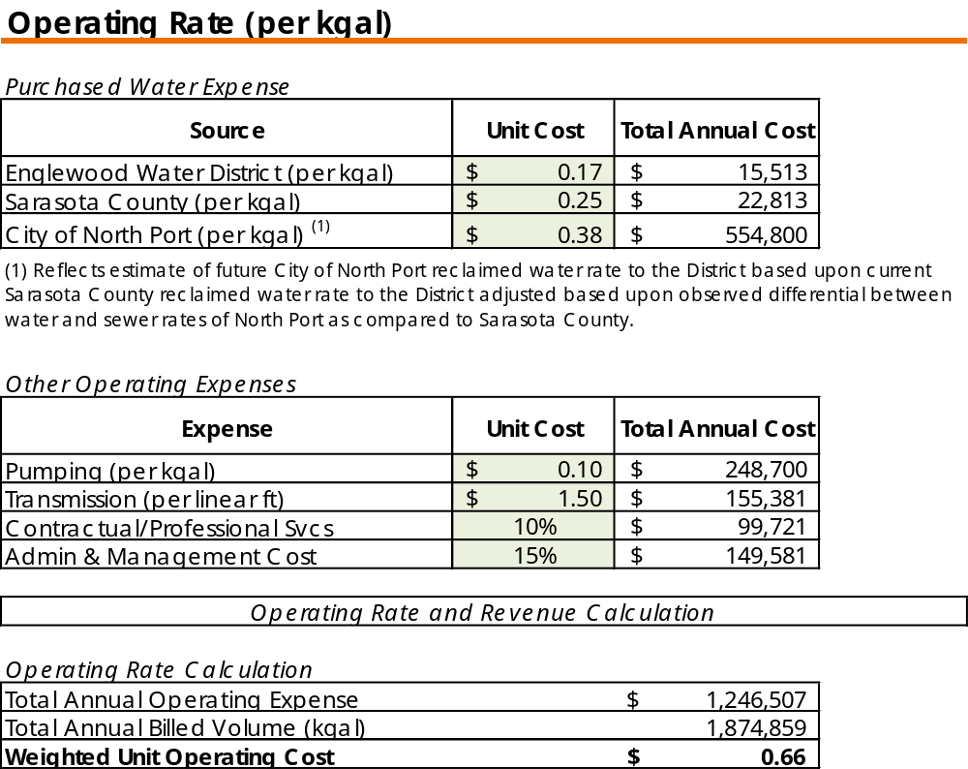
Results: Operating Rate

Slide 7
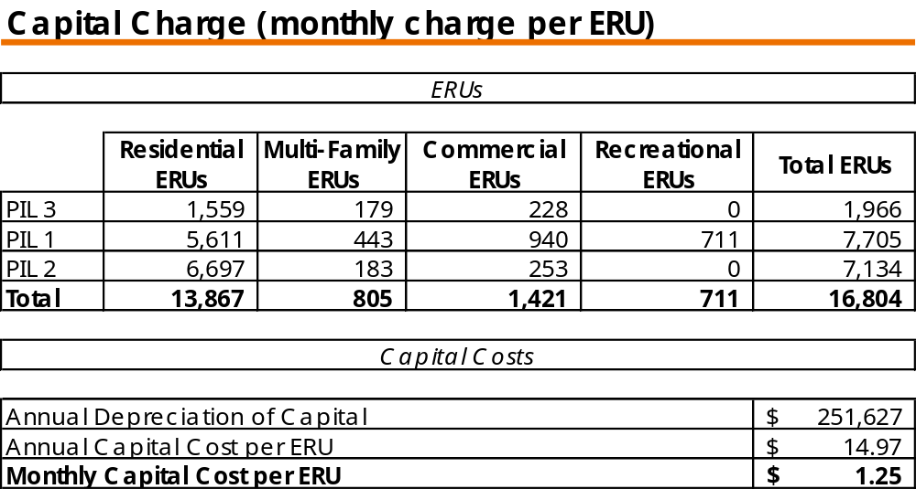
Results: Capital Charge

Slide 8
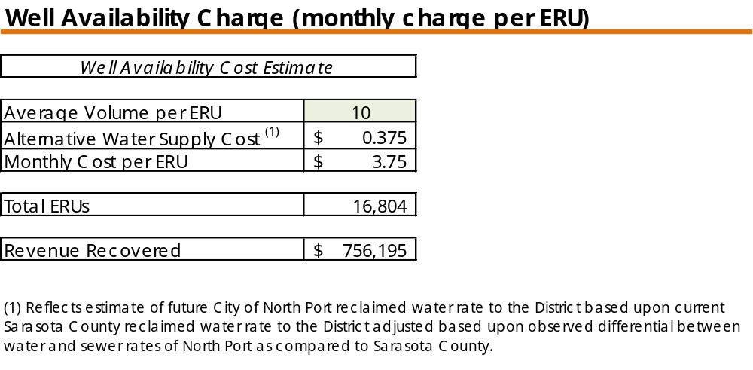
Results: Groundwater Availability Charge

Slide 9
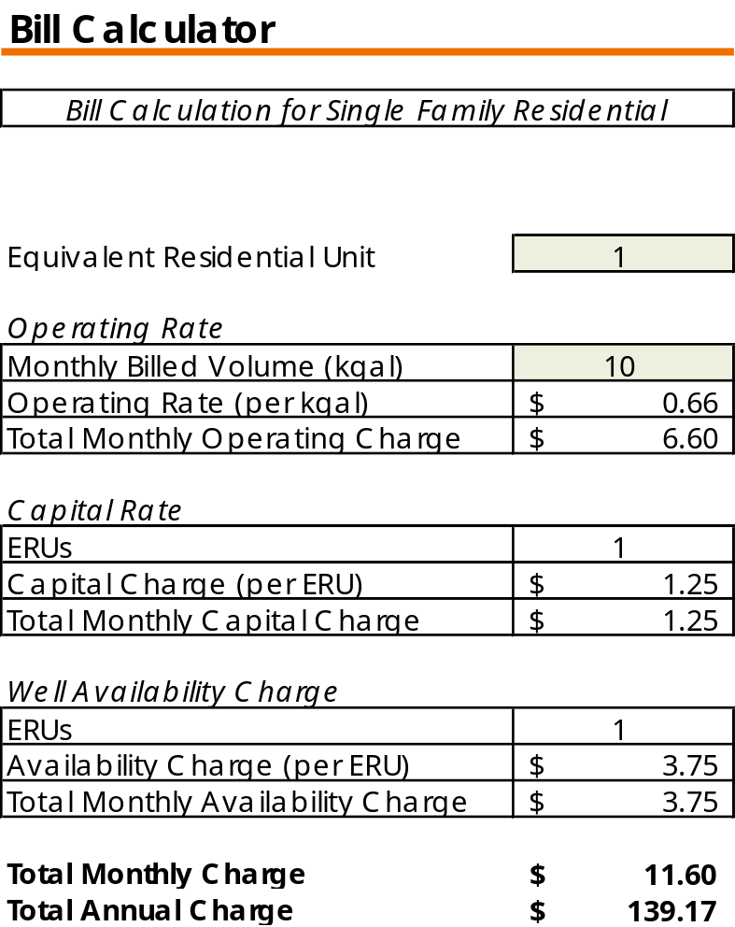
Results: Single-Family Residential Monthly Bill

Slide 10
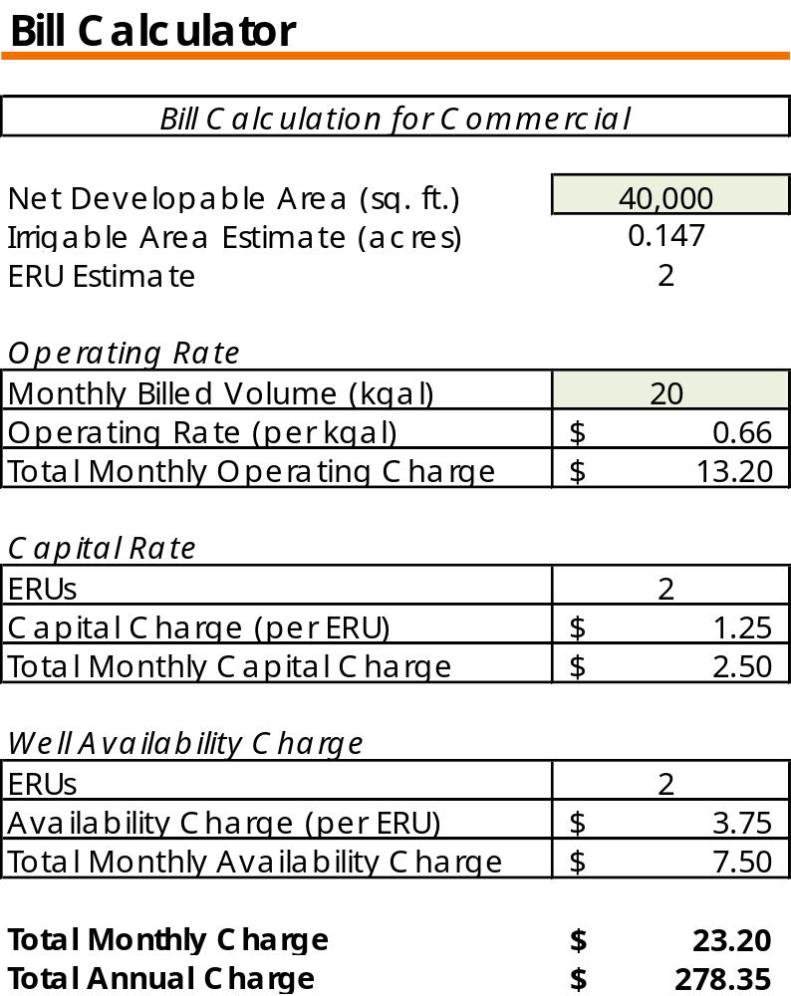
Results: Commercial Monthly Bill

Slide 11
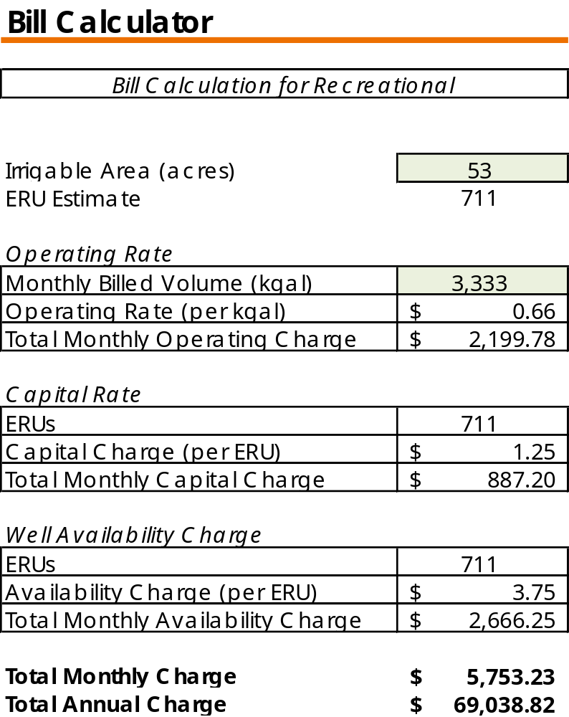
Results: Recreational Customer Monthly Bill

Slide 12
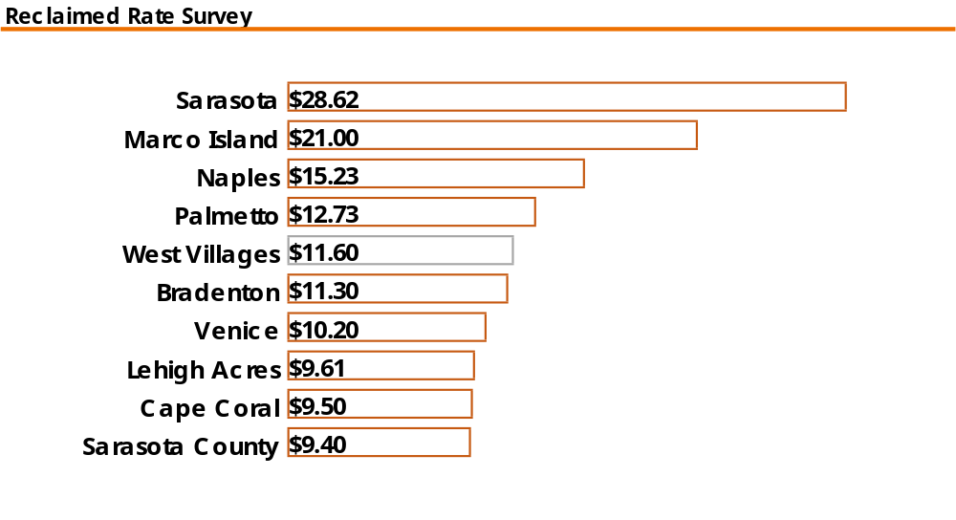
Irrigation & Reclaimed Water Rate Survey

Slide 13
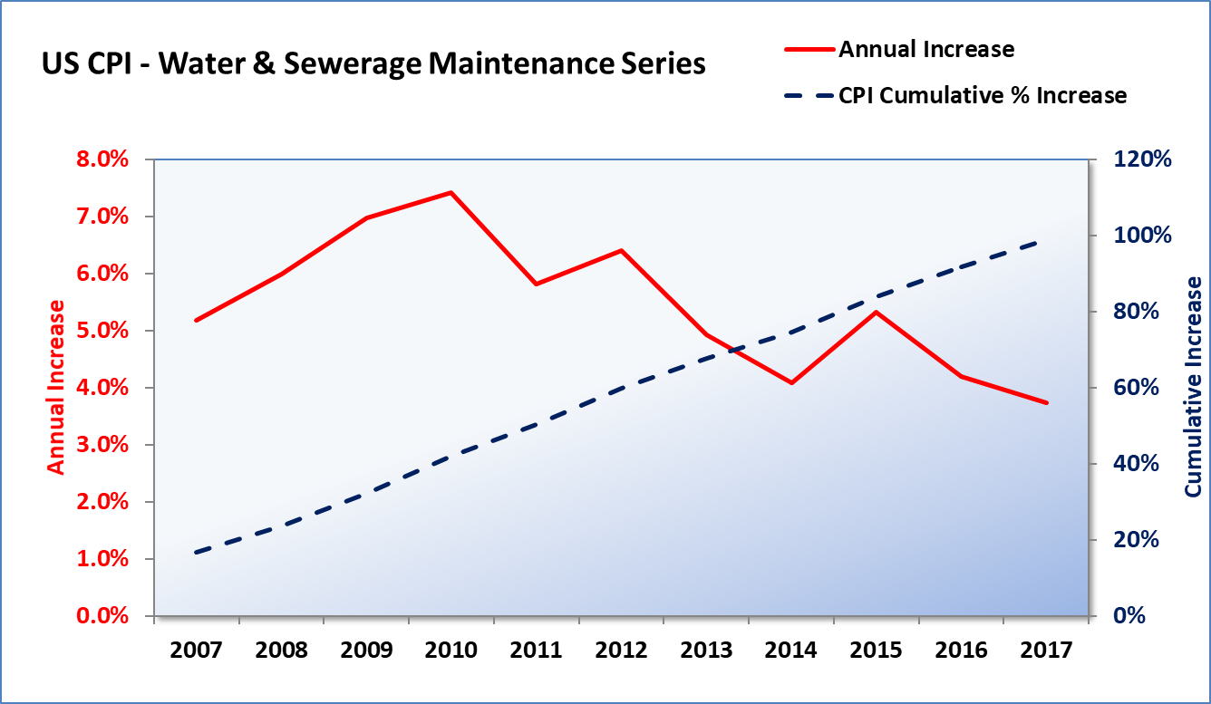
National Industry Trend
Measures the national average change in the cost of water and sewer service to households
Specific and relevant to utilities than overall CPI
10-year average annual increase = 5.5%

Slide 14
Recommendations
Adopt recommended rates for implementation in FY 2019
Annually index rates to be the maximum of the current year’s CPI Water & Sewerage Series or the Series’ 10-yr. average of 5.5%
Update rate study periodically (every 2-3 years)
  Account for known costs, pace and types of development, demands, and other information that may impact the overall costs for the District

Slide 15

Questions and Discussion

